Slide 1
AWS Data Protection,
Encryption & Privacy Compliance
DEPI GRADUATION PROJECT · CLOUD SECURITY
Classify it, encrypt it, guard the path, find what leaks — and prove each control with evidence.
Ahmed Ali · Ahmed Shaaban · Ammar · Mohamed Essam Elbastawisy
Notes:
Welcome. We built an audit-ready data protection lab on AWS in four weeks, using only fake data. Every claim in this talk has evidence in our GitHub repository.

Slide 2




Protect data at every stage — and be able to prove it to an auditor
THE GOAL
At rest
In transit
In use
Proven
S3, RDS, DynamoDB, EBS and Glacier encrypted with our own KMS keys.
TLS 1.2+ everywhere, secrets never in code, a protected API.
Macie finds misplaced data; GuardDuty flags suspicious access.
21 deliverables mapped to GDPR, HIPAA and PCI DSS, each with evidence.
Notes:
The project is not about turning services on. It is about showing, with evidence, that each control works — the way an auditor would ask.

Slide 3
Four owners, four weeks, one shared account
TEAM & PLAN
Week | Owner | Focus
Kickoff | Ahmed Ali | Account hardening, Identity Center + MFA, budget, CloudTrail, repo
1 | Ahmed Shaaban | Data lifecycle, classification, S3 secure baseline, access review
2 | Ammar | KMS key hierarchy, key policies, rotation, encrypted data stores
3 | Mohamed Essam | Demo API, TLS/ACM, Secrets Manager, Cognito, WAF
4 | Ahmed Ali | Macie, GuardDuty, DLP plan, compliance matrix, risk register
Notes:
Everyone works every week in parallel: for example, Ammar creates the KMS keys early so S3 uses SSE-KMS from day one, and Mohamed builds the demo app skeleton in week 1.

Slide 4
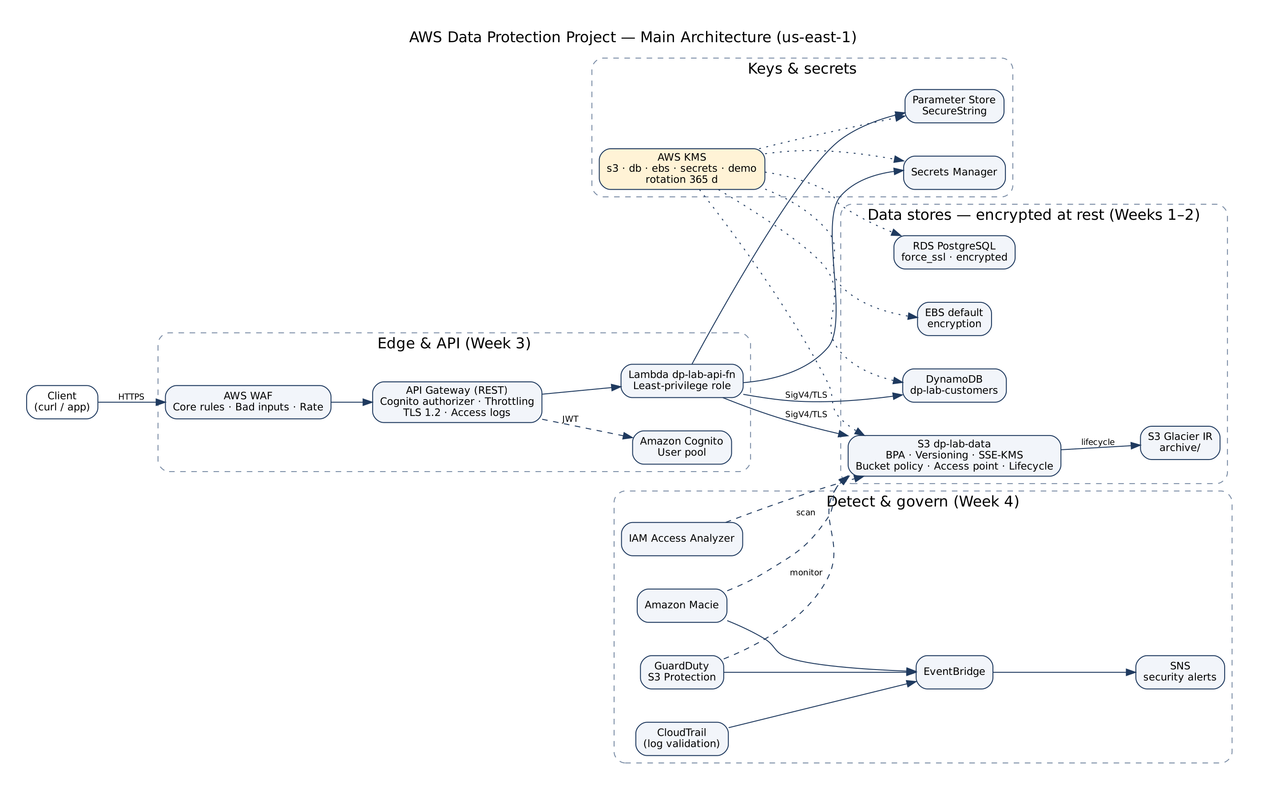
Architecture — one region, layered controls
Notes:
Left to right: the request path is protected by WAF, Cognito and TLS. The data stores are all encrypted with customer managed KMS keys. Underneath, Macie, GuardDuty, Access Analyzer and CloudTrail feed EventBridge, which emails the team.

Slide 5
Classify first, then lock down S3
WEEK 1 · AHMED SHAABAN
4 levels: Public · Internal · Confidential · Restricted
Prefix + DataClassification tag on every object
Block Public Access (account + bucket), ACLs off
Versioning, SSE-KMS, server access logs
Bucket policy: HTTPS only, TLS ≥ 1.2, KMS only
Access point scoped to internal/ for analytics
Lifecycle: Restricted kept 180 days, then deleted
Proof
$ aws s3 cp products.csv s3://…/public/ --sse AES256
→ AccessDenied
$ get-object internal/staff-directory.csv
→ OK (via access point)
$ get-object restricted/payments.csv
→ AccessDenied
Notes:
Classification drives everything after it. The proof: an upload asking for the wrong encryption is denied, and the analytics role reads internal data through the access point but is denied on restricted data.

Slide 6
Our keys, our rules: AWS KMS
WEEK 2 · AMMAR
5 customer managed keys: s3 · db · ebs · secrets · demo
Key admins can't decrypt; key users can't manage
Automatic rotation every 365 days
Grants: temporary access, created then revoked
S3, RDS, DynamoDB, EBS, Glacier IR all encrypted
Alarm email on DisableKey / PutKeyPolicy
CloudHSM compared, not provisioned (cost)
Proof
$ aws s3api head-object …payments.csv
"ServerSideEncryption": "aws:kms"
"BucketKeyEnabled": true
$ aws kms disable-key (demo key)
$ aws kms decrypt …
→ DisabledException
Notes:
Envelope encryption: the KMS key never leaves KMS; it encrypts data keys that encrypt the data. Separation of duties is in the key policy. Disabling the demo key shows crypto-shredding: no key, no data.

Slide 7
Guard the path: TLS, secrets, API
WEEK 3 · MOHAMED ESSAM
Demo API: API Gateway → Lambda → DynamoDB / S3
TLS 1.2 policy; HTTP and TLS 1.1 refused
Secrets Manager + SecureString, KMS-encrypted
Rotation: AWSCURRENT / AWSPREVIOUS versions
Cognito authorizer, throttling 5 rps, AWS WAF
Lambda role: one table, one secret, one prefix
RDS forces SSL; VPN / IPsec designed
Proof
$ openssl s_client -tls1_1 …
→ handshake failure
$ list-secret-version-ids
→ AWSCURRENT, AWSPREVIOUS
No secret in code, env vars,
logs or the repo.
Notes:
Every hop is labelled with its protection. The Lambda returns no personal data and logs only a safe line. Secret values are never shown — only their versions.

Slide 8
Find what leaks: Macie, GuardDuty, DLP
WEEK 4 · AHMED ALI
Macie job at 100% sampling + custom EmployeeID identifier
GuardDuty S3 Protection; sample findings explained
EventBridge → SNS email for high findings
DLP plan: prevent · detect · respond · measure
Compliance matrix with an evidence link per row
Risk register with owners and treatments
The planted mistake
We hid card numbers inside internal/notes-export.csv.
Macie flagged CREDIT_CARD_NUMBER in an "Internal" file.
Fix: moved to restricted/, re-tagged, access logs reviewed, logged as risk R-01.
Notes:
Classification alone cannot catch people pasting card numbers into a harmless export. Macie did. Remind the committee that GuardDuty findings are samples, labelled as such.

Slide 9
LIVE DEMO · THE API ANSWERS FOR ITSELF
401
200
429
403
No token — Cognito rejects the call
Valid token — data returned, no PII
60-request burst — throttled
XSS payload — blocked by AWS WAF
Plus: wrong-encryption upload denied · HTTP refused · disabled key can't decrypt · alarm email received.
Notes:
Run scripts/demo-commands.sh live. Get a fresh Cognito token just before presenting. Keep screenshots as backup if the network fails.

Slide 10
Controls mapped to GDPR, HIPAA and PCI DSS
Control | GDPR | HIPAA | PCI DSS | Status
Classification & inventory | Art. 30 | 164.308(a)(1) | 12.5.2 | Implemented
Encryption at rest | Art. 32(1)(a) | 164.312(a)(2)(iv) | 3.5 | Implemented
Encryption in transit | Art. 32(1)(a) | 164.312(e)(1) | 4.2 | Implemented
Least privilege | Art. 25, 32 | 164.312(a)(1) | 7 | Partial
Audit logging | Art. 5(2), 30 | 164.312(b) | 10.2 | Implemented
Threat detection & response | Art. 33, 34 | 164.308(a)(6) | 10.4, 12.10 | Implemented
"Mapped to", not "compliant": fake data in a lab cannot be certified. Full matrix: week-4-compliance/compliance-matrix.xlsx
Notes:
14 controls in the full matrix, each linked to an evidence file in the repo. Least privilege is partial because every lab member has AdministratorAccess — an accepted, documented risk.

Slide 11
Top risks and how we treat them
ID | Risk | Score | Treatment
R-01 | Sensitive data in a lower-classified place | 16 · High | Reduce: recurring Macie discovery
R-03 | Secrets pushed to GitHub | 15 · High | Reduce: CloudShell only, push protection
R-05 | AdministratorAccess for all lab members | 12 · Medium | Accept (lab only): MFA, CloudTrail, teardown
R-07 | PII exposed in logs or API responses | 12 · Medium | Reduce: no PII returned, safe log lines
R-02 | Bucket made public by mistake | 10 · Medium | Reduce: BPA, Access Analyzer, alert
R-04 | KMS key deleted → data unrecoverable | 10 · Medium | Reduce: separation of duties, 7–30 day wait
Notes:
Score is likelihood times impact, each 1 to 5. The full register with all eight risks, owners and residual risk is in week-4-compliance/risk-register.xlsx.

Slide 12
Honest limits, and what production needs
Limits of this lab
For production
Fake data, one account, four weeks
Broad admin access for the team
CloudHSM, VPN, VPC endpoints: design only
GuardDuty findings are samples
AWS Organizations + SCPs, least-privilege roles
Private data paths through VPC endpoints
Automated Macie discovery, Security Hub
Rotation Lambdas, infrastructure as code
Notes:
Saying what we did not do is part of being audit-ready. Every design-only control is labelled that way in the matrix.

Slide 13
Questions?
Every deliverable, policy and runbook is in the repository.
github.com/Mohamed-Essam153/AWS-Data-Protection-Project
Notes:
Thank the committee. Offer to open any evidence file live from the repo.

